Slide 1
Causal Reasoning
Hanna Co

Slide 2
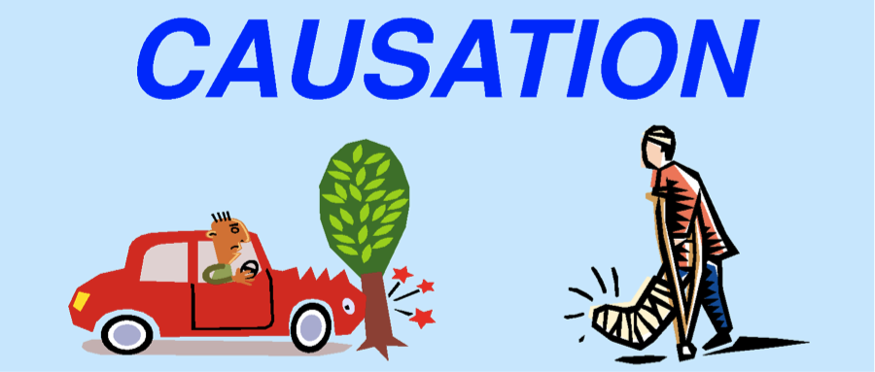
Traditional View on Causality
Direct cause, or one of many factors?
e.g., reckless driving causes accidents, you will fail the course because you are lazy
Exceptions
"my neighbors roof gets wet when mine gets wet" + "if I hose my roof it will get wet" → "my neighbor's roof gets wet whenever I hose mine"
Notes:
we say something causes something, but in fact, it is not a direct cause, but it just makes the consequences more likely
causal expressions are subject to exceptions

Slide 3
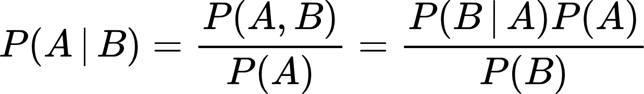
Probability Theory & Notation
allows us to focus on causality without paradoxes
Basic Probability
0 ≤ P(A) ≤ 1
P(A) + P(¬A) = 1
P(A or B) = P(A) + P(B) - P(A and B)
Conditional probability
Causal Effect of X = x on Y = y: Pr(Y=y|do(X=x)) = Pr(y|do(x)) = Pr(y_{x})

Slide 4
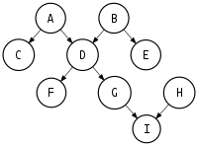
Graphs
A way to
express assumptions
represent joint probability
facilitate inferences from observations
Terminology:
root, sink
parent, descendant, non-descendant
directed acyclic graph (DAG)
Note: acyclic graphs allow us to make assumptions about independence, but we cannot infer causality from them (yet!)
Notes:
A node is connected to its parents by a single incoming arrow. Node D has two parents, A and B, which F only has one parent, D. The descendants of a node are all the nodes that can be reached from that node. As an example, the descendants of D are F, G, and I. H is not a descendant of D because there is no directed path from D to H. Finally, the non-descendants of a node are all all nodes other than its parents and descendants. The non-descendants of D would be C, E, and H.

Slide 5
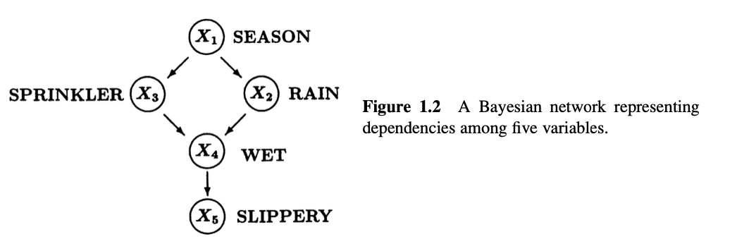
Bayesian Networks
a directed (acyclic) graph used to represent causal or temporal relationships
nodes - variables that take on values
assigned a probability distribution
arrows - direct relationships

Slide 6
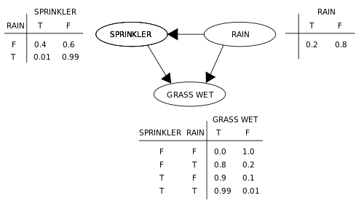
An Example
P(W) = P(W|¬S, ¬R) P(¬S|¬R) P(¬R)
+ P(W|¬S, R) P(¬S|R) P(R)
+ P(W|S,¬R) P(S|¬R) P(¬R)
+ P(W|S, R) P(S|R) P(R)
P(W) = 0
+ (0.8)(0.99)(0.2)
+ (0.9)(0.4)(0.8)
+ (0.99)(0.01)(0.2)
P(W) = 0.44838

Slide 7
Markov Property
Causal Markov Condition: each variable X_{i} is independent of all its nondescendants given its parents PA_{i}
knowing X4 renders X5 independent of {X1, X2, X3}
Notes:
given the present, the future does not depend on the past

Slide 8
d-separation
W
X
Y
X
W
Y
W
X
Y
sequential
divergent
convergent
A set Z is said to d-separate X from Y if and only if Z blocks every path from a node in X to a
node in Y.
d-separation implies independence
Notes:
sequential & divergent - blocked if W in Z
convergent - blocked if W not in Z
intuitively - knowing W makes X and Y independent of each other in sequential and divergent
not knowing W making X and Y independent of each other in convergent

Slide 9
d-separation
dsep_{G}(X₅, X₄, {X1, X2, X3})

Slide 10
Types of Queries
Predictions
Interventions
Counterfactuals
something didn't happen, but would it have given some conditions
what would happen based on our observations
what would happen if we took action
Notes:
prediction: would the pavement be slippery if we find the sprinkler off?
intervention: would the pavement be slippery if we make sure that the sprinkler is off?
counterfactual: would the pavement be slippery had the sprinkler been off, given that the pavement is in fact not slippery and the sprinkler is on?

Slide 11
Identifiability
The causal effect of X on Y is identifiable from a graph G if the quantity P(y_{x}) can be computed uniquely from any positive probability of the observed variables – that is, if P_{M1}(y_{x}) = P_{M2}(y_{x}) for every pair of models M₁ and M₂ with P_{M1}(v) = P_{M2}(v) > 0 and G(M₁) = G(M₂) = G.
In other words, the causal effect is identifiable when we have enough information to determine the causal effect.
All causal effects are identifiable when the model is Markovian!

Slide 12
Determining Identifiability
Front-door Criterion
incomplete
Back-door Criterion
incomplete
do-calculus
complete!
Notes:
incomplete - can tell you that a query is identifiable, but not that it's not identifiable
complete - can tell you identifiable or not

Slide 13
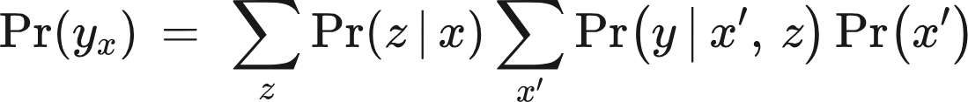
Front-door Criterion
A set of variables Z is said to satisfy the front-door criterion relative to an ordered pair of variables (X, Y) if:
Z intercepts all directed paths from X to Y
There is no unblocked back-door path from X to Z
All back-door paths from Z to Y are blocked by X.
If we find such a set Z and P(x, y) > 0, then we can write
*constraints of front-door criterion are strict and thus rarely used*

Slide 14
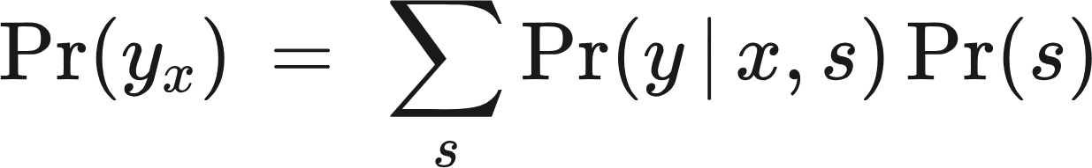
Back-door Criterion
A set of variables S satisfies the back-door criteria if
No element of S is a descendant of X
The elements of S “block” all “back-door” paths from X to Y , namely all paths that end with an arrow pointing to X.
This allows us to write

Slide 15
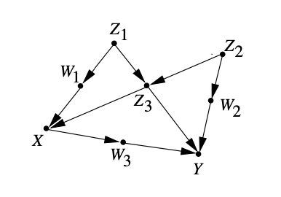
Back-door Criterion
Back-door sets: {Z₁, Z₃} and {Z₂, Z₃}

Slide 16
Rules of do-calculus
Ignore Observations:
Action/observation exchange:
Ignoring Actions:
Notes:
d-sep relative to altered graph
bar over - remove edges pointing into X
bar under - remove edges outgoing from X
Z(W) - remove edges pointing into vars of Z if Z is not an ancestor of W

Slide 17
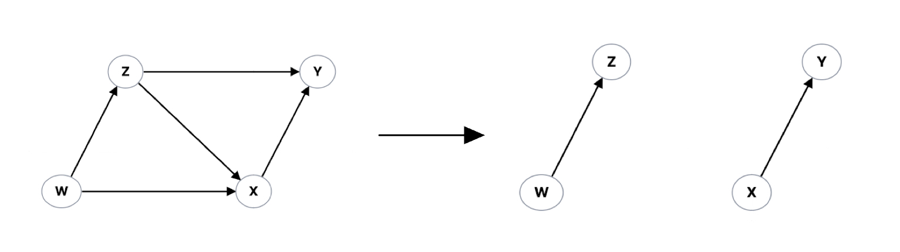
do-calculus Example
? → yes!

Slide 18
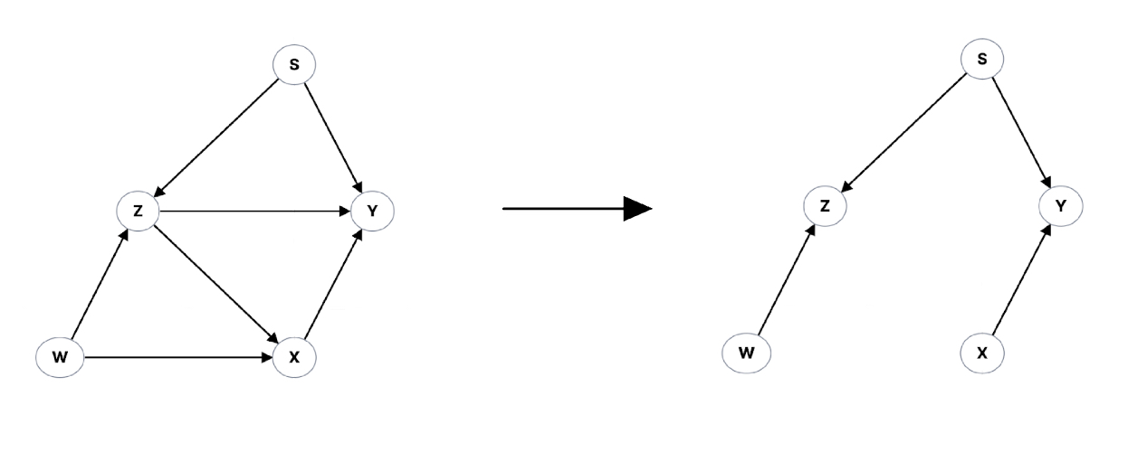
do-calculus Example
? → no!

Slide 19
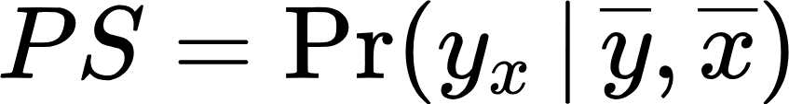
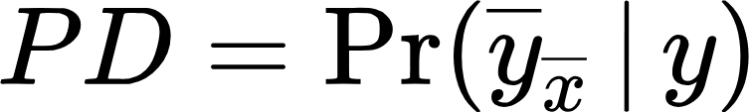
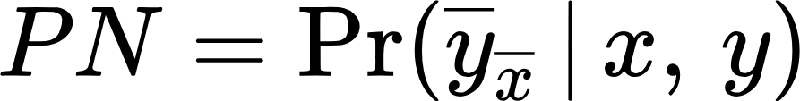
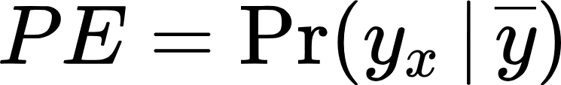
Probability of …
Sufficiency
Disablement
02
04
01
03
Necessity
Enablement

Slide 20
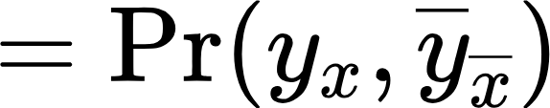
More on Sufficiency and Necessity
probability that Y would not have occurred in the absence of X, given that X and Y did in fact occur
PN
applications in epidemiology, and legal
PNS
y responds to x both ways
probability that Y would have occurred had X occurred
PS
applications in policy analysis, AI, psychology
Notes:
epidemiology - the probability that disease would not have occurred in the absence of exposure, given that disease and exposure did in fact occur. (prob. we can attribute disease to exposure)

Slide 21
Example: Was Radiation the Cause of Leukemia?
PNS = Pr(y_{x},y'_{x'}) = 0.0001625 ⇒ There is a 1.625 in ten thousand chance that a randomly chosen child would both die of leukemia if exposed and survive if not exposed
PN = Pr(y'_{x'}|x,y) = 0.37462 ⇒ There is a 37.462% chance that an exposed child who died from leukemia would have survived had he or she not been exposed
PS = Pr(y_{x}|x',y') = 0.000162 ⇒ There is a 1.62 in ten thousand chance that any unexposed surviving child would have died of leukemia had he or she been exposed
Notes:
example from data taken from Finkelstein and Levin 1990

Slide 22
XAI: Explainable AI
we don't always understand ML models
counterfactual: how to yield a different output?
basic and complete causal certification
does this XAI approach pass?
Notes:
ML models aid us in decision making, but the models are not fully understood – we don't know exactly why they make the decisions that they do
counterfactual reasoning - how the model inputs need to change in order to yield a different output
basic causal certification - a guarantee that the information provided to the users is always genuine causal information
complete causal certification - guarantee that the information provided to users is always a complete account of the causal factors that led the model to deliver a particular outcome
Pearl's work is relevant because it defines causation, which is important because they want to determine if counterfactual approaches identify genuine causal dependence
Pearl-Woodward framework can be used to test if an existing approach to XAI passes basic or complete causal certification

Slide 23
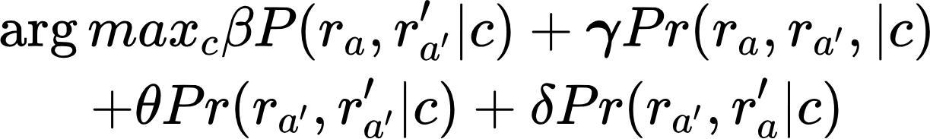
Unit Selection
Definition
aims to identify a set of individuals who are most likely to exhibit a desired mode of behavior
Objective Function
Notes:
always-takers, never-takers, responders, contrarians
example: subscription renewal

Slide 24
Applications
Recommendation
Medicine
how does popularity affect recommendations?
what are the side effects of a vaccine?
Psychiatry
Pricing
how do symptoms interact and what sustains them?
how can we optimize pricing?
Notes:
recommendation: popularity bias issues (over-recommend popular items), and used Pearl's work to understand causal relationship b/w pop. and rec. and used do-calculus to remove impact of pop.
medicine: side-effect of covid vaccine, and used back-door criterion of account for population diffs and remove causal paths (b/c study was observational)
psychiatry: built an network of mental disorder symptoms and how they interact, and proposed using this for diagnosis and treatment (counterfactual)
pricing: wants to describe demand as a causal effect of price, competing prices, promotion, season and used BNs to reason about these relationships

Slide 25
References
Baron, Sam. (2023). Explainable AI and Causal Understanding: Counterfactual Approaches Considered. Minds and Machines. 33. 1-31. 10.1007/s11023-023-09637-x.
Borsboom, Denny. (2017). A network theory of mental disorders. World Psychiatry. 16. 5-13. 10.1002/wps.20375.
Li, Ang & Pearl, Judea. (2019). Unit Selection Based on Counterfactual Logic. 1793-1799. 10.24963/ijcai.2019/248.

Slide 26
References
Menni, Cristina & Klaser, Kerstin & May, Anna & Polidori, Lorenzo & Capdevila, Joan & Louca, Panayiotis & Sudre, Carole & Nguyen, Long & Drew, David & Merino, Jordi & Hu, Christina & Selvachandran, Somesh & Antonelli, Michela & Murray, Benjamin & Canas, Liane & Molteni, Erika & Graham, Mark & Modat, Marc & Joshi, Amit & Spector, Tim. (2021). Vaccine side-effects and SARS-CoV-2 infection after vaccination in users of the COVID Symptom Study app in the UK: a prospective observational study. The Lancet. Infectious diseases. 21. 10.1016/S1473-3099(21)00224-3.
Pearl J. Causality. 2nd ed. Cambridge University Press; 2009.
Pearl, Judea. (2009). Causal Inference in Statistics: An Overview. Statistics Surveys. 3. 96-146. 10.1214/09-SS057.

Slide 27
References
Wenjuan, Wei & Feng, Lu & Chunchen, Liu. (2018). Mixed Causal Structure Discovery with Application to Prescriptive Pricing. 5126-5134. 10.24963/ijcai.2018/711.
Zhang, Yang & Feng, Fuli & He, Xiangnan & Wei, Tianxin & Song, Chonggang & Ling, Guohui & Zhang, Yongdong. (2021). Causal Intervention for Leveraging Popularity Bias in Recommendation.

Slide 28
Thank you!

Slide 29
Learning the days of the week infographics
Mercury
Earth
It's the closest planet to the Sun
Earth is a planet that has life
02
04
01
03
Mars
Saturn
Mars is actually a very cold place
It’s a gas giant and has rings

Slide 30
Learning the days of the week infographics
In the morning
Mars is actually a very cold place
Earth is a planet that has life
Mercury is the smallest planet

Slide 31
Learning the days of the week infographics
 | Monday | Tuesday | Wednesday | Thursday | Friday
Mercury | Mercury is the closest planet to Sun
Saturn |  |  | Saturn is composed of hydrogen and helium
Earth |  | Earth is the third planet from the Sun
Jupiter |  |  |  | Jupiter is the biggest planet of them all

Slide 32
Learning the days of the week infographics
50%
83%
Mercury is a very small planet
Jupiter is the biggest planet
75%
26%
Venus is the second planet from the Sun
Saturn is a gas giant and has rings

Slide 33
Learning the days of the week infographics
Jupiter
Jupiter is the biggest planet in the entire Solar System
Mercury
Mercury is the smallest planet in the entire Solar System
Mars
Despite being red,
Mars is actually a very cold place

Slide 34
Learning the days of the week infographics
85%
75%
Venus
Mercury
Venus is the second planet from the Sun
It’s the smallest planet of them all
95%
50%
Jupiter
Mars
It’s the biggest planet of them all
Despite being red, Mars is a cold place

Slide 35
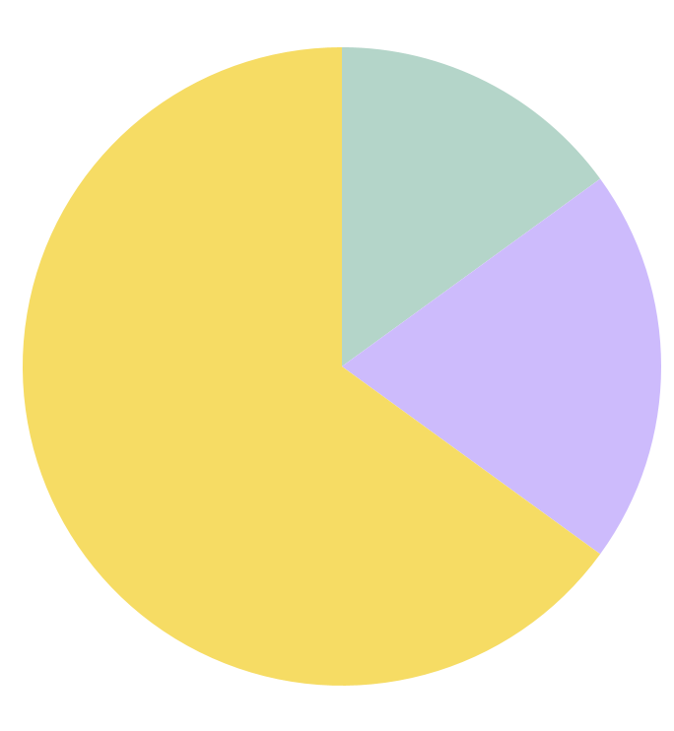
Learning the days of the week infographics
Venus
15%
Venus is the second planet from the Sun
Mercury
20%
Mercury is a very small planet
Jupiter
65%
Jupiter is the biggest planet
Follow the link in the graph to modify its data and then paste the new one here. For more info, click here

Slide 36
Learning the days of the week infographics
Mercury
Jupiter
Venus
It's the closest planet to the Sun
Jupiter is the biggest planet
Venus has a beautiful name
Saturn
Mars
Earth
Saturn is the ringed planet
Despite being red, Mars is very cold
Earth is a planet that has life

Slide 37
Learning the days of the week infographics
85%
95%
Saturn
Mercury
Saturn is a gas giant and has several rings
Mercury is the smallest planet in the Solar System

Slide 38
Learning the days of the week infographics
 | Monday | Tuesday | Wednesday | Thursday | Friday
Week 1
Week 2
Week 3
Week 4

Slide 39
Learning the days of the week infographics
Jupiter
Mercury
Jupiter is the biggest planet
Mercury is a small planet
Saturn
Mars
Saturn is the ringed planet
It's actually a very cold place

Slide 40
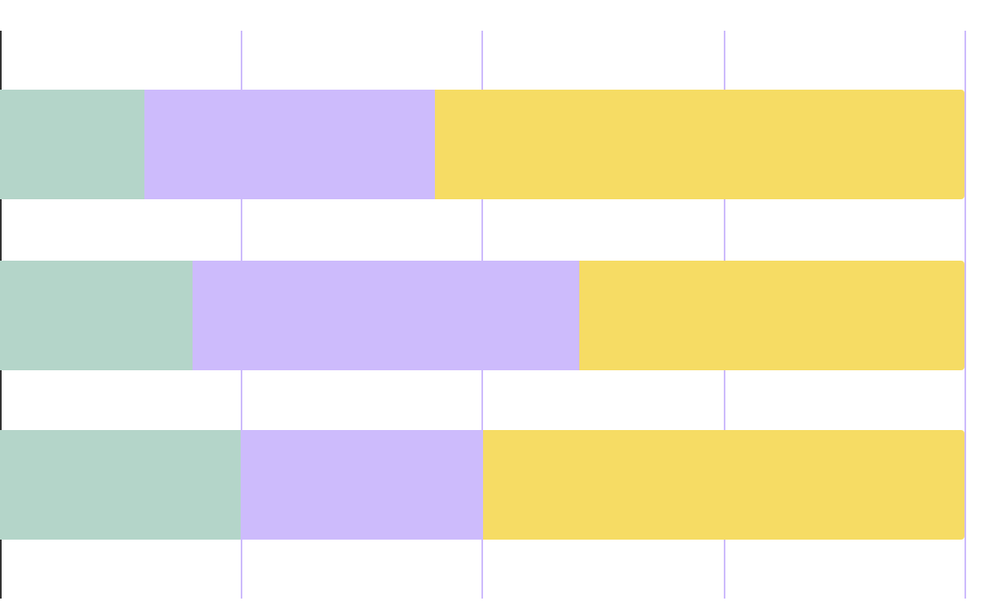
Learning the days of the week infographics
Mercury
Mon
Mercury is the closest planet to the Sun
Mars
Tues
Despite being red, Mars is a cold place
Wed
Saturn
Saturn is a gas giant and has rings
25%
50%
75%
100%
Follow the link in the graph to modify its data and then paste the new one here. For more info, click here

Slide 41
Learning the days of the week infographics
Mercury
Mercury is a small planet
Mars
Mars is actually a cold place
Jupiter
Jupiter is the biggest planet

Slide 42
Learning the days of the week infographics
55%
63%
45%
75%
Mercury
Saturn
Mars
Jupiter
Mercury is a small planet
Saturn is the ringed planet
It's actually a very cold place
Jupiter is the biggest planet

Slide 43
Learning the days of the week infographics
7 days
3 months
4 weeks
Mercury is the closest planet to the Sun
Jupiter is the biggest planet in the Solar System
Saturn is a gas giant and has several rings

Slide 44
Learning the days of the week infographics
Monday | Tuesday | Wednesday | Thursday | Friday | Saturday | Sunday
1 | 2 | 3 | 4 | 5 | 6 | 7
8 | 9 | 10 | 11 | 12 | 13 | 14
15 | 16 | 17 | 18 | 19 | 20 | 21
22 | 23 | 24 | 25 | 26 | 27 | 28
29 | 30 | 31 | 1 | 2 | 3 | 4

Slide 45
Learning the days of the week infographics
Jupiter
Jupiter is the biggest planet
Saturn
Saturn is the ringed planet
Mercury
Mercury is a small planet
Mars
Mars is a very cold place

Slide 46
Learning the days of the week infographics
Jupiter
Mars
Jupiter is the biggest planet
Mars is a very cold place
Mercury
Ceres
Mercury is a small planet
Ceres is in the asteroid belt

Slide 47
Learning the days of the week infographics
It's a gas giant and the biggest planet of them all
Jupiter
It's the fourth-brightest object in the night sky
Solar System
It's the closest planet to the Sun and the smallest one
Mercury
It’s name has nothing to do with the liquid metal

Slide 48
Learning the days of the week infographics
Venus
Earth
It has a beautiful name
This is where we all live on
Saturn
Mercury
It has several rings
It's the smallest planet
Jupiter
Mars
It's the biggest planet
It's a very cold place

Slide 49
Learning the days of the week infographics
Mercury
It’s a small planet
Mars
It’s a very cold place
Saturn
It’s the ringed planet
Earth
90%
75%
60%
45%
It harbors life

Slide 50
Learning the days of the week infographics
Venus is the second planet from the Sun and has a beautiful name
Jupiter is a gas giant and the biggest planet in the Solar System
Saturn, the ringed planet, is composed mostly of hydrogen and helium
Mercury is the closest planet to the Sun and the smallest of them all

Slide 51
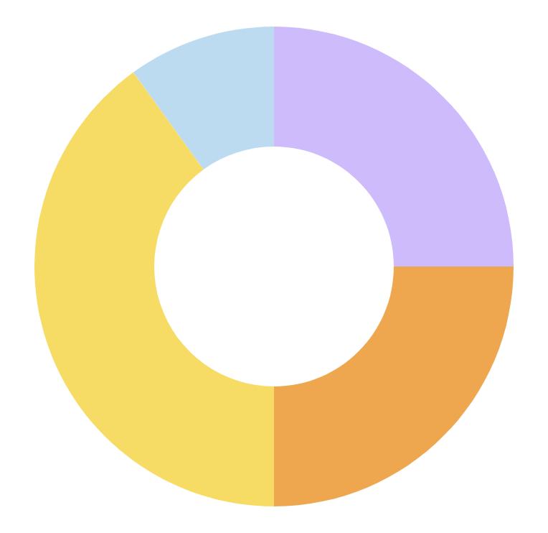
Learning the days of the week infographics
Mercury
Mars
Mercury is a small planet
It's actually a very cold place
Saturn
Jupiter
Saturn is the ringed planet
Jupiter is the biggest planet
Follow the link in the graph to modify its data and then paste the new one here. For more info, click here

Slide 52
Learning the days of the week infographics
Saturn
Mercury
Saturn is a gas giant and has several rings
Mercury is the smallest planet in the Solar System
Jupiter
Mars
Jupiter is the biggest planet in the Solar System
Despite being red, Mars is actually a cold place

Slide 53
Learning the days of the week infographics
Saturn
Saturn is a gas giant and has several rings
Jupiter
Jupiter is the biggest planet in the Solar System
Mercury
Mercury is the smallest planet in the Solar System
Mars
Despite being red, Mars is a very cold place

Slide 54
Learning the days of the week infographics
Saturn
Mercury
79%
90%
Saturn has several rings
Mercury is the smallest planet
Earth
Mars
50%
25%
Earth is a planet that has life
Mars is a very cold place

Slide 55
Learning the days of the week infographics
Saturn
Saturn has several rings
Earth
Mercury
Earth is a planet that has life
Mercury is the smallest planet

Slide 56
Learning the days of the week infographics
65%
Mars
It's full of iron oxide dust, which gives the planet its reddish cast
45%
Neptune
It’s the fourth-largest planet in the Solar System

Slide 57
Learning the days of the week infographics
Jupiter
Venus
Saturn
Earth
Jupiter is the biggest planet of them all
Venus is the second planet from the Sun
Saturn is a gas giant and has several rings
Earth is the planet that harbors life

